Slide 1
Final Project presentation
Rahul Kumar Singh
6th August 2021

Slide 2


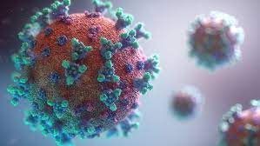
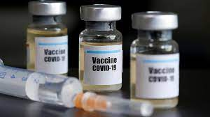
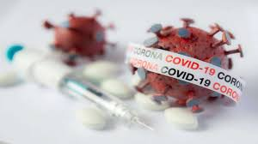
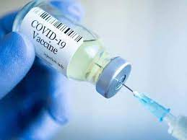

Vaccination program

Slide 3
Problem solving
How many peoples got vaccinated?
How many peoples get 1st dose of vaccination?
How many peoples get fully vaccinated(2nd dose)?
How many peoples remain getting 2nd Dose of vaccination?
How many peoples get daily vaccination?
How many peoples vaccinated per hundred?
How many people vaccinated per million?
Tell us about which country used what vaccine and what’s its amount according to the month?
Count the vaccine which country used what vaccine according to the month?
What is sum of vaccine manufactured by the countries?

Slide 4
Charts
Problem 1
How many peoples got vaccinated?

Slide 5
Problem 2
How many peoples get 1st dose of vaccination?

Slide 6
Problem 3
How many peoples get fully vaccinated(2nd dose)?

Slide 7
Problem 4
How many peoples remain getting 2nd Dose of vaccination?

Slide 8
Problem 5
How many peoples get daily vaccination?

Slide 9
Problem 6
How many peoples vaccinated per hundred?

Slide 10
Problem 7
How many people vaccinated per million?

Slide 11
Problem 8
Tell us about which country used what vaccine and what’s its amount according to the month?

Slide 12
Problem 9
Count the vaccine which country used what vaccine according to the month?

Slide 13
Problem 10
Which countries manufacture the vaccine to its amount and its name?

